Slide 1
Automate Diagnosis & Consultant(adc)
(changing the way to presenting and detection of any diagnosis.)
PCS23-11
Domain: Full Stack + Machine Learning
Objective
The objective of developing an automated system is to reduce health care costs by reducing physical hospital visits, hospitalizations, and diagnostic testing procedures.
Team members:
Ayush Srivastava
1900290120029
Ankit Yadav 1900290120016
Under the Guidance of
Mr. Harsh Khatter
Assistant Professor Department of Computer Science

Slide 2
PROBLEM STATEMENT
In such unprecedented times, with a fragile healthcare infrastructure, the medical facilities for people are scarce and even fewer for people with special needs. The healthcare sector got so preoccupied with Covid-19 cases that people with other ailments didn't even get a chance to avail medical assistance. So, We are here to present a model to mitigate the scarcity of facilities and the lack of medical management.

Slide 3
SOLUTION
Integration of clinical decision support with computer-based patient records could
Reduce medical errors.
Automated Diseases Prediction System.
Doctor Recommendation System
Online Consultation/Appointment with Labs/Doctors.
Path-labs Booking
Decentralized Patient Records
Integrate doctors and patients via an interactive and user-friendly interface so that Patients can easily utilize it in emergency situations.

Slide 4
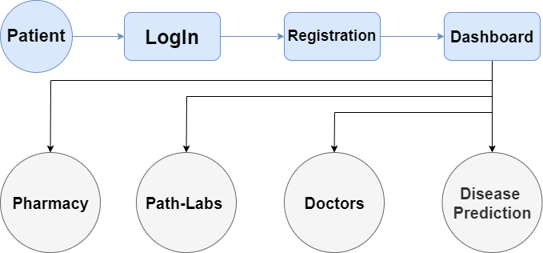
METHODOLOGY

Slide 5
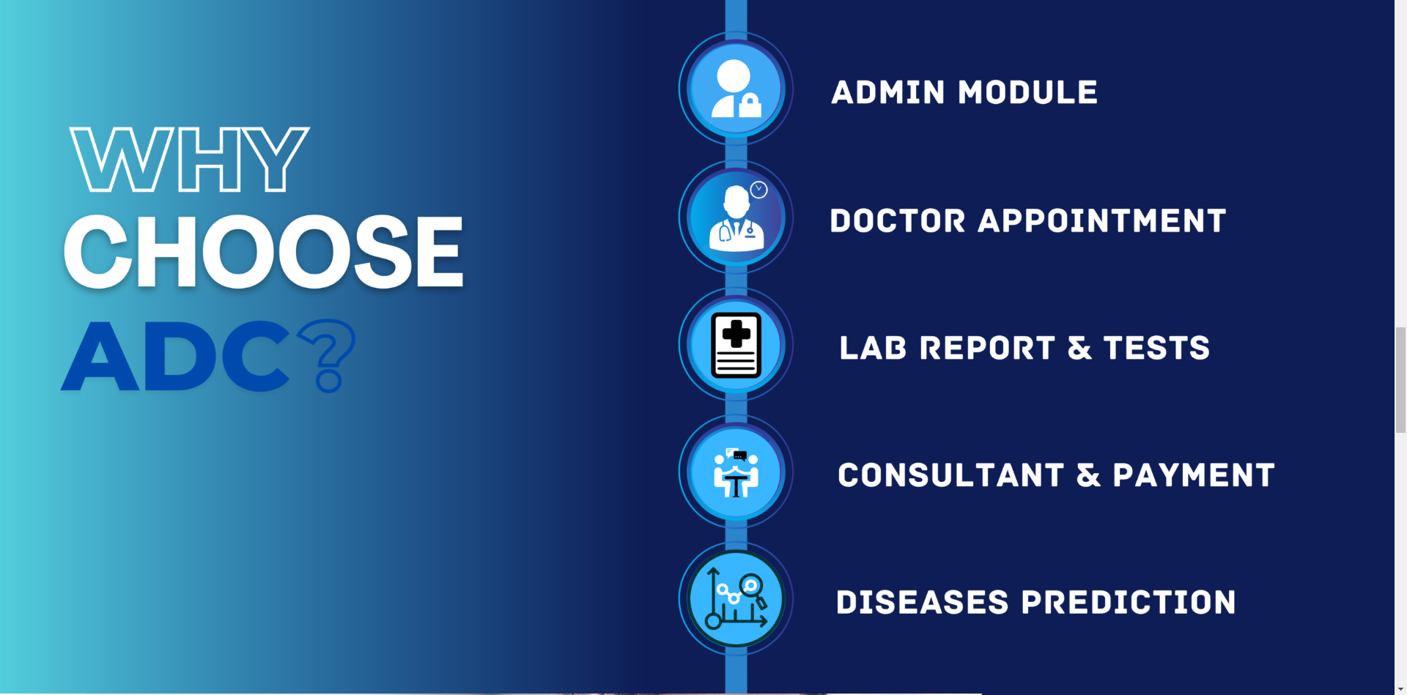
ADC Features

Slide 6
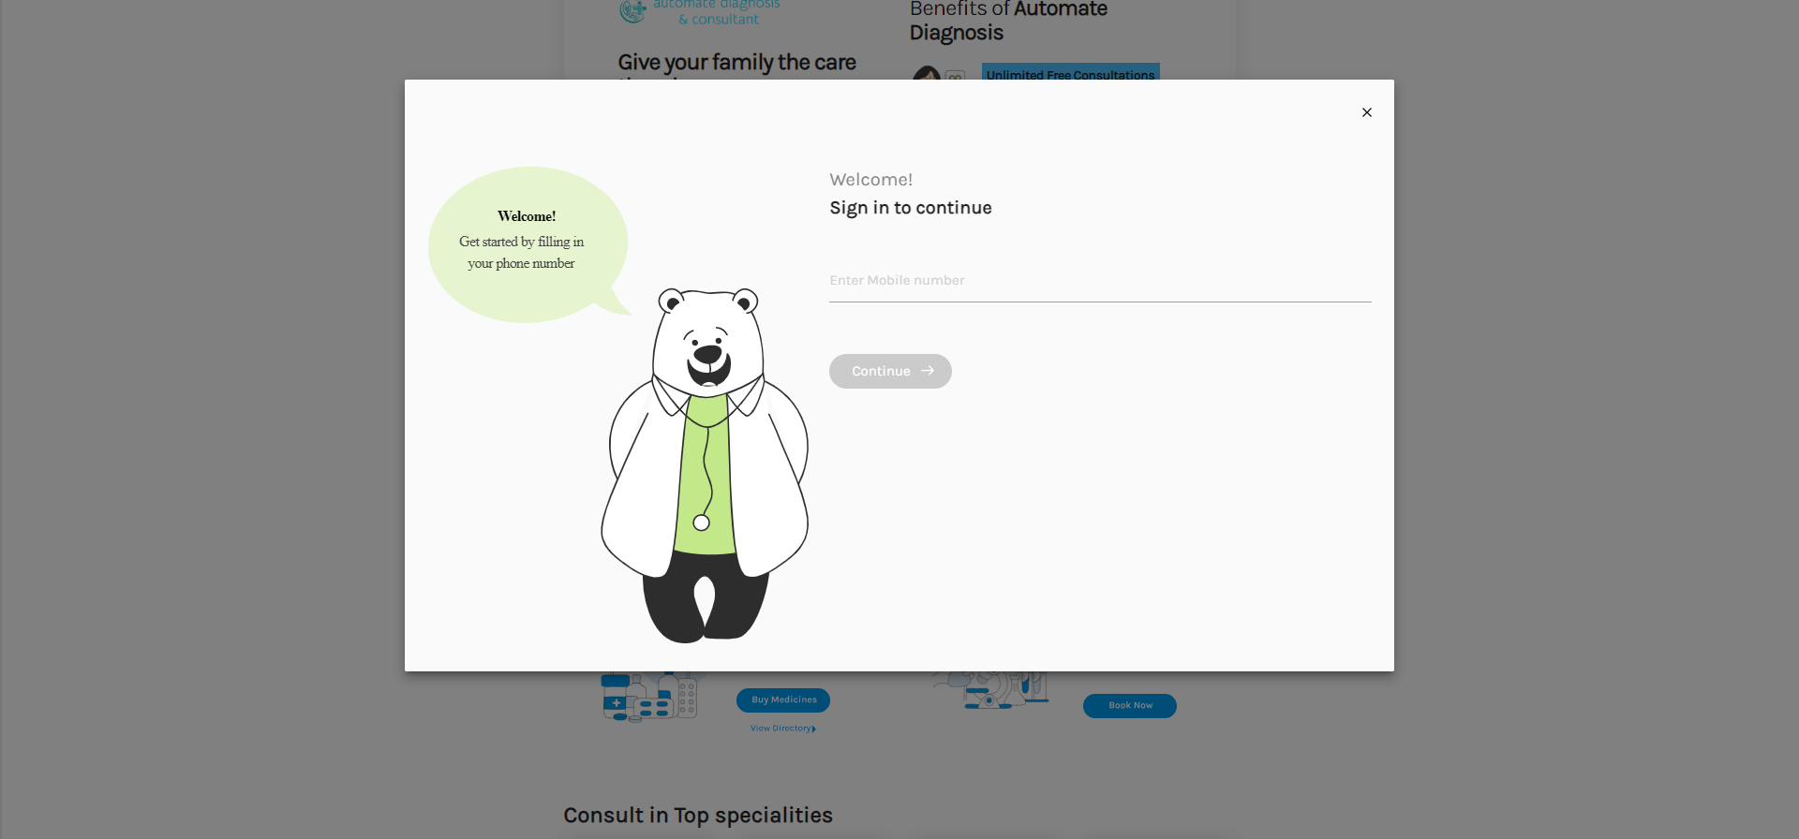
Authentication Module

Slide 7
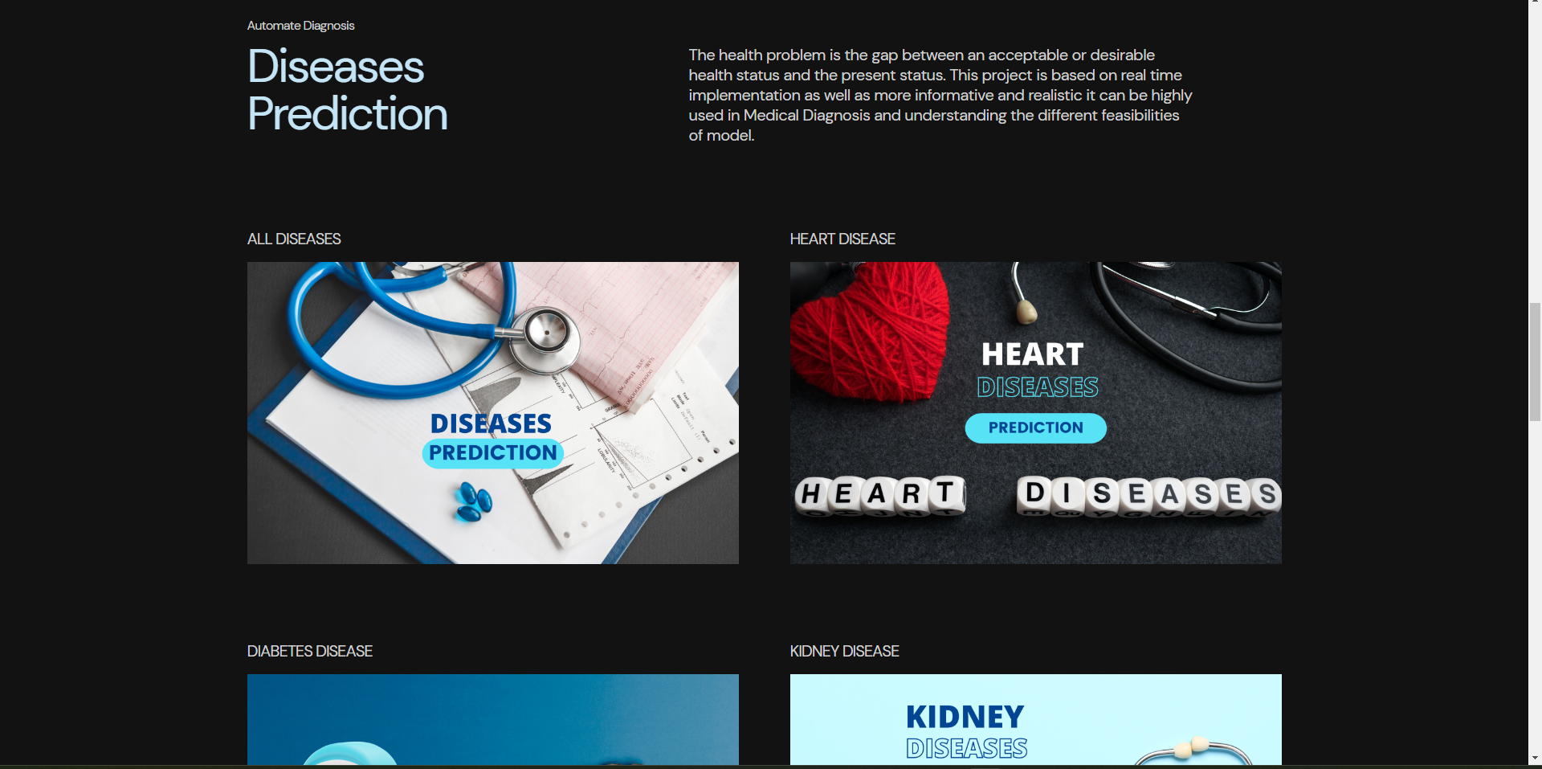
Disease prediction module

Slide 8

Prediction module

Slide 9
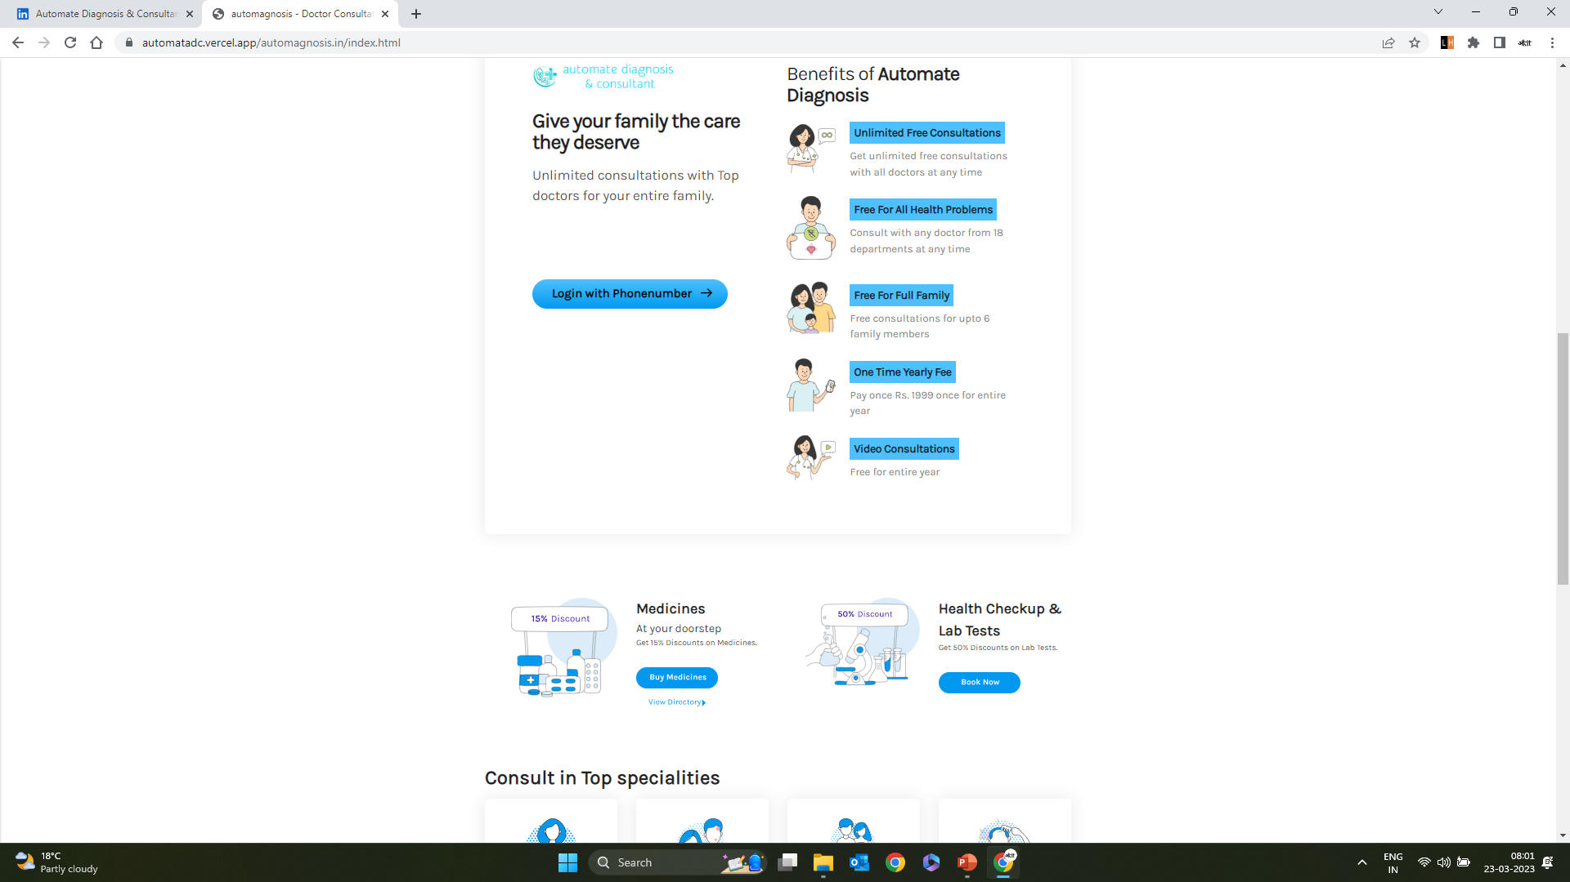
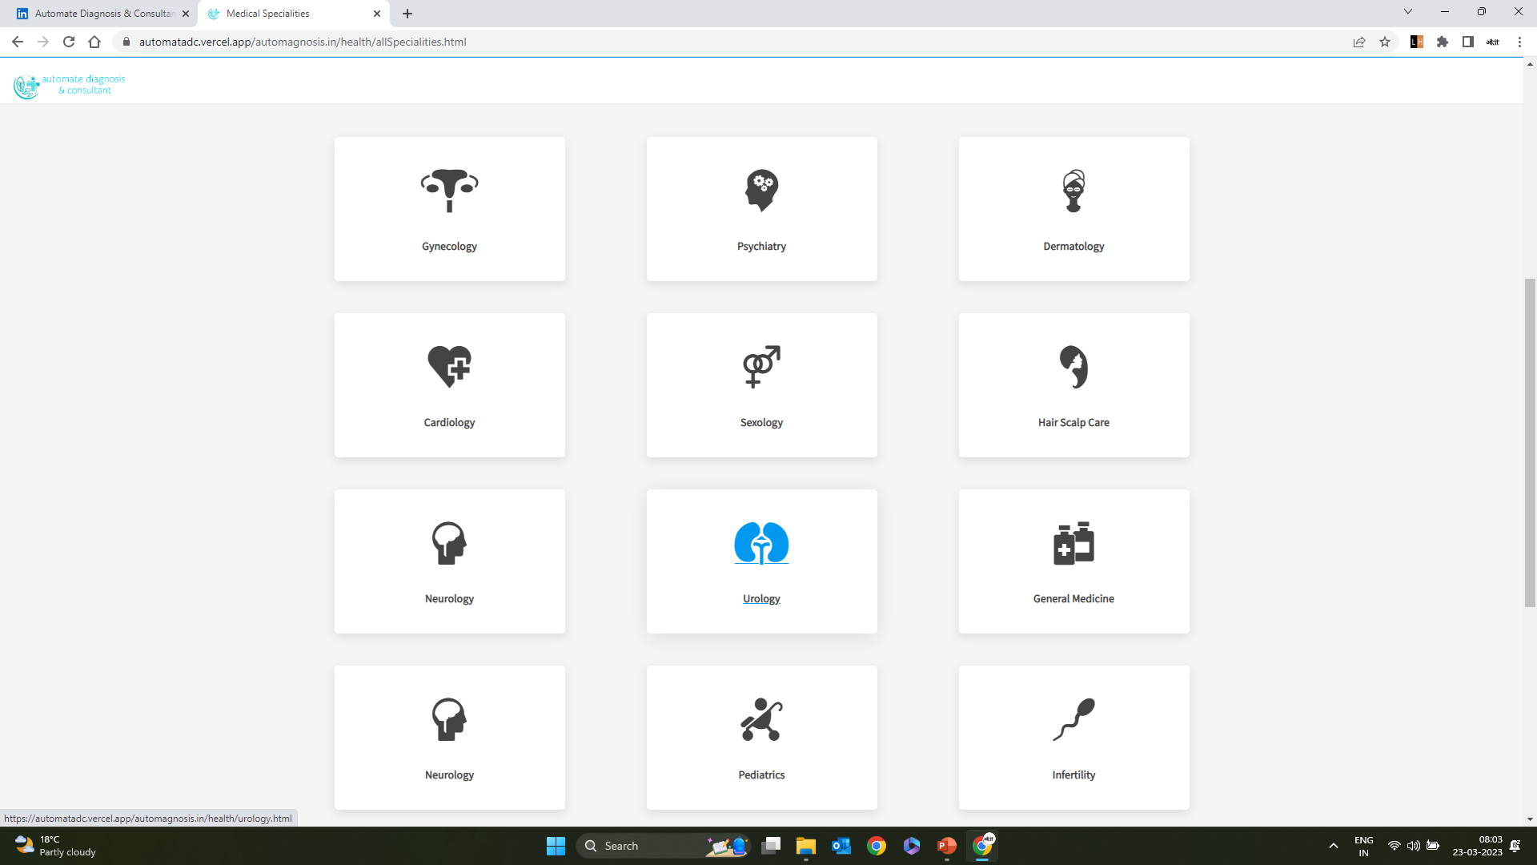
Doctor Recommendation
Module
All diseases available

Slide 10
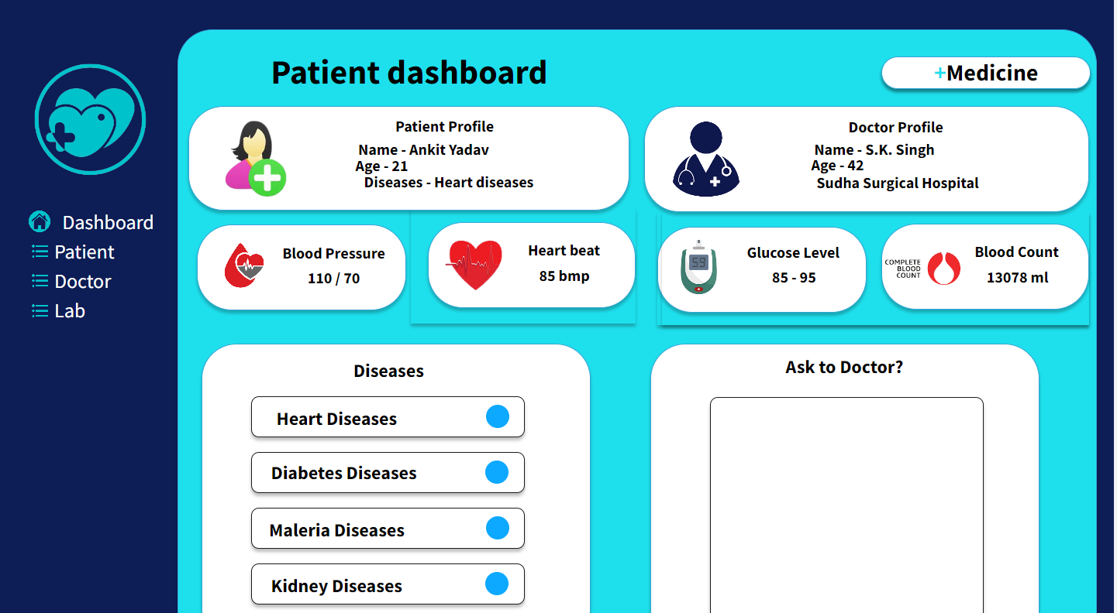
Patient Dashboard

Slide 11
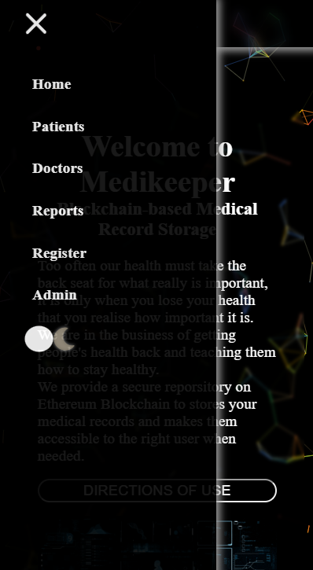
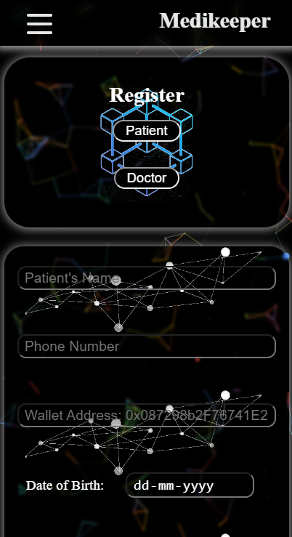
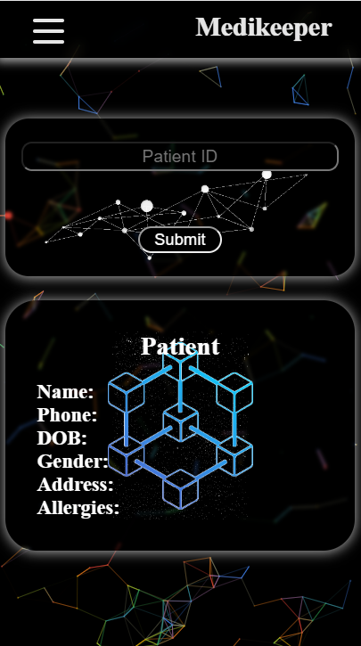
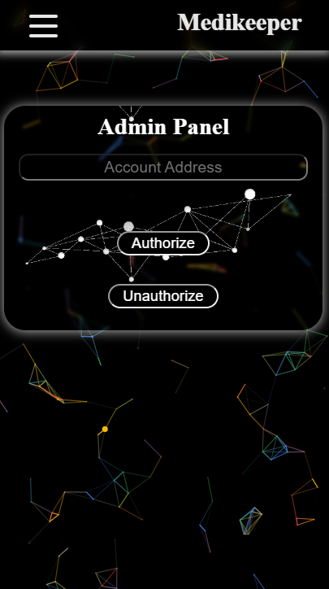
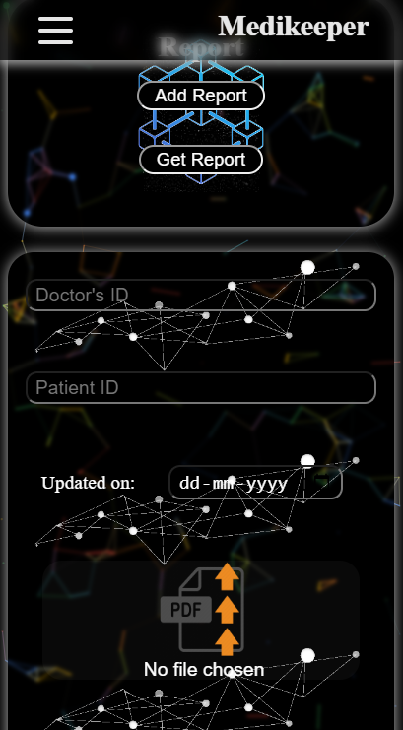
Decentralized Medical Records

Slide 12



Technology Stack
Web Development
Frontend: HTML, CSS, JavaScript, ReactJs, NextJs.
Backend: NodeJs, ExpressJs MongoDB.
Blockchain
Solidity, IPFS, Hardhat,
Web3Js, Web3.storage, GOERLI, MetaMask, Etherscan, Truffle.
Machine Learning
Anaconda, Jupyter-Notebook, EDA, NumPy, Pandas, Matplotlib, Pandas, Sklearn, ML & DL Algorithms.

Slide 13
OUTCOME OF THE PROJECT
Research Paper Published
Patent published

Slide 14
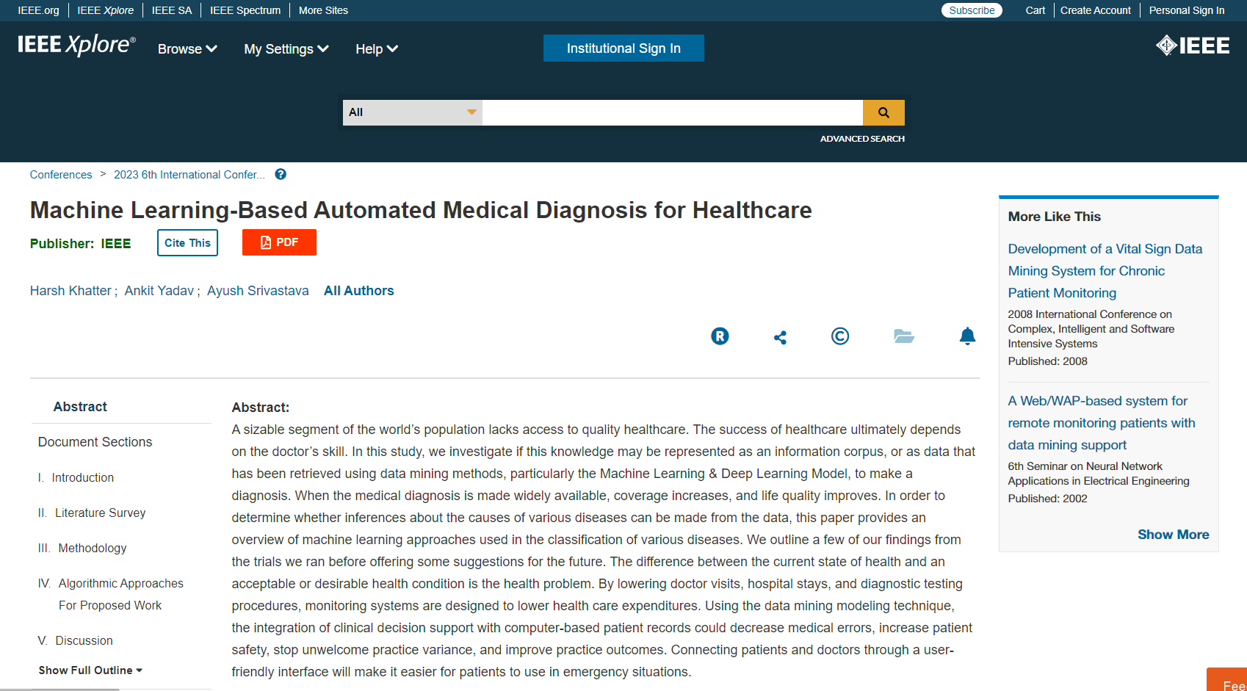
Research Paper
https://ieeexplore.ieee.org/document/10112144

Slide 15
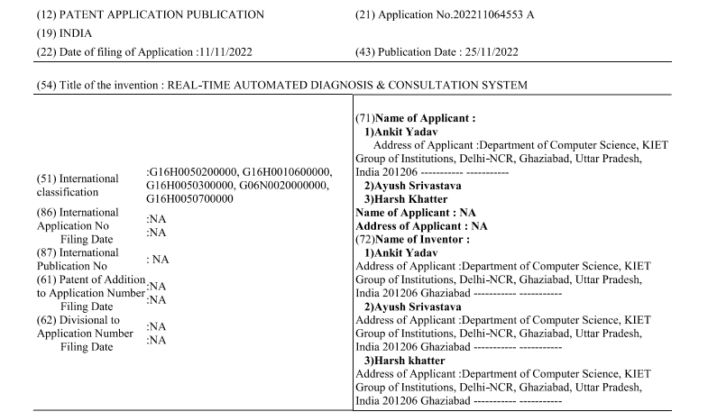
Patent
Application Number- 202211064553, Indian Patent Journal Number- 47/2022, Date of Filing: 2022-11-11, Date of Publication: 2022-11-25, Title of Invention: Real-Time Automated Diagnosis & Consultation System.

